Slide 1
Data-based Arguments
TANIA OMMER

Slide 2
Hypothesis Testing using z-scores and P-values
Position:
Global warming is real, as seen by the increase in average temperatures around the world over the years.
Null Hypothesis: There is no significant increase in average temperatures around the world over the years. The temperature changes are random and don’t prove global warming.
Alternative Hypothesis: There is a significant change and increase in average temperatures around the world as time goes on, proving global warming is real.

Slide 3
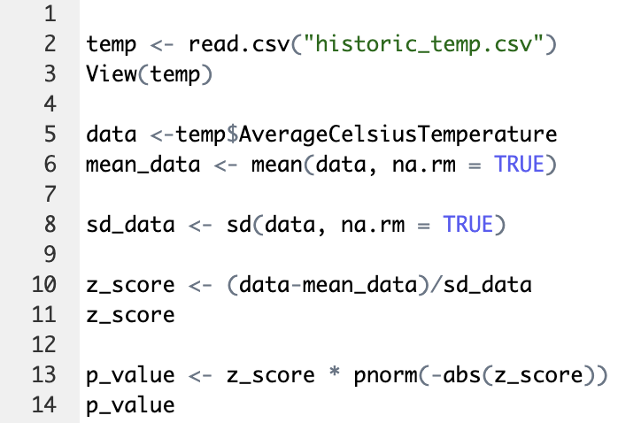
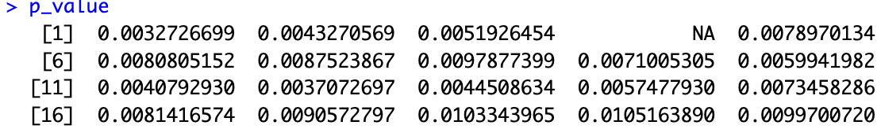
To calculate the p-values for this test, we use the “Average Celsius Temperature” column from the data set. This calculates the p-values for all entries in the data. However, using p-hacking, we can choose to only focus on the first 20 entries in the data, all from Australia. These individual p-values ranged from 0.003 – 0.01. Since these values are very small, we reject our null hypothesis that the average temperature changes have nothing to do with global warming being real.

Slide 4
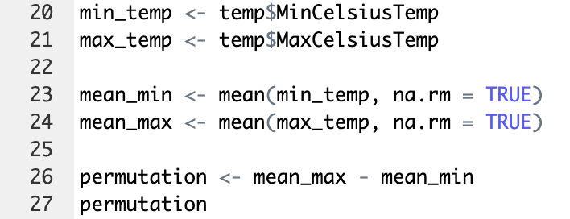

Hypothesis Testing using the Permutation test
Using the MinCelsiusTemp and MaxCelsiusTemp columns for Australia, the permutation p-value comes out to 10.37. Such a large value proves that there was a significant increase in temperature around the world over the past years. Therefore, we reject the null hypothesis.

Slide 5
Conclusion
Both the hypothesis test using z-scores and p-values, and the hypothesis test using the permutation test reject the null hypothesis, which stated that the changes in temperatures around the world were random and do not prove global warming.
Therefore, the data gathered from the tests proves there was a significant change and increase in temperatures around the world. Therefore, global warming is real.

